Slide 1
Resume Score Calculator: Enhancing Recruitment with AI

Slide 2
Project Overview
Introduction to the Resume Score Calculator, a tool designed to assist in evaluating resumes against job descriptions using GPT-powered insights.
Overview of key features:
User-friendly GUI for uploading resumes and job descriptions.
Integration with OpenAI's GPT for intelligent resume scoring.
Immediate feedback on the resume's relevance to the job requirements.

Slide 3
Setup and Installation
Requirements:
Python 3.6 or newer.
tkinter for the GUI (comes pre-installed with Python for Windows. For Linux, install using your package manager).
OpenAI Python package (openai).
Installation Steps:
Ensure Python and pip are installed.
Install OpenAI package using pip: pip install openai.

Slide 4
Running the Script
Instructions for running the script:
Open terminal or command prompt.
Navigate to the script's directory.
Run the script using Python: python resume_score_calculator.py.
User Guide:
How to upload a resume and job description using the GUI.
Initiating the scoring process with a click of a button.

Slide 5
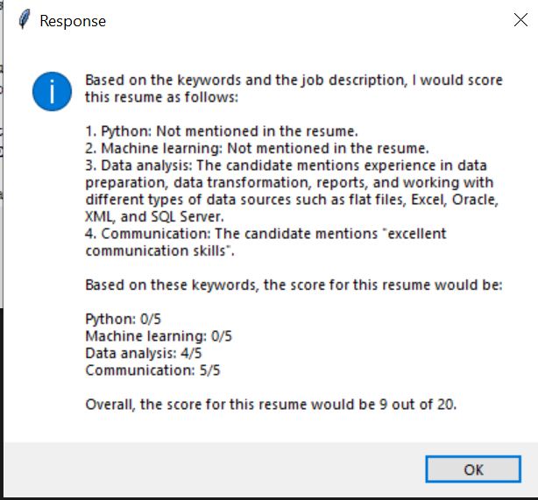
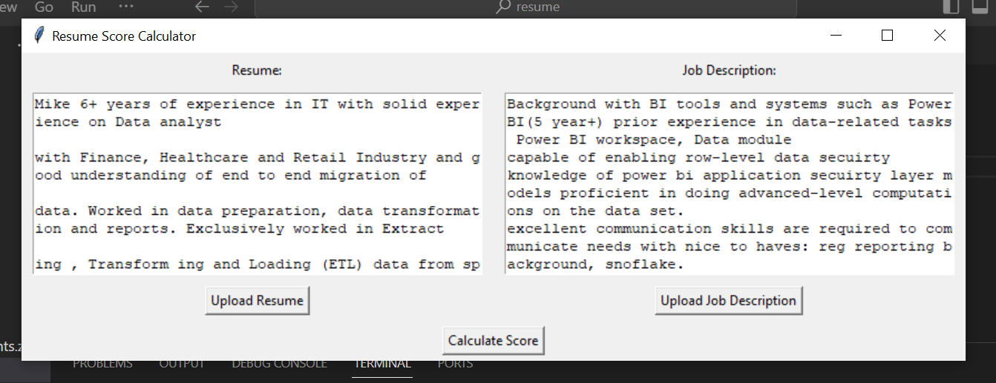
Understanding Output and Usage

Slide 6
Thank You

